Slide 1
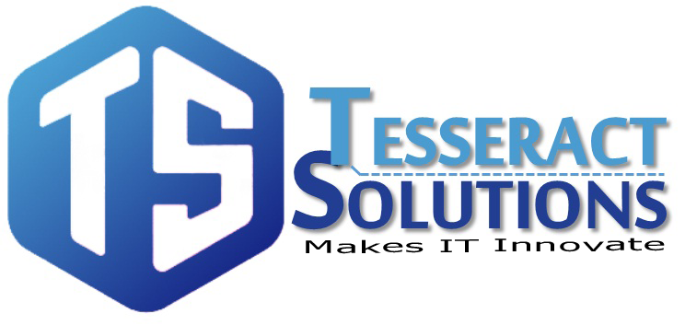
https://www.facebook.com/tesseractspl
https://www.linkedin.com/company-beta/11222535/

Slide 2

AWS Database Services

Slide 3

AGENDA
Introduction
AWS Database Services
Amazon RDS
Amazon Aurora
Amazon DynamoDB
Amazon Redshift
Amazon Elasticache
Amazon Database Migration Services

Slide 4
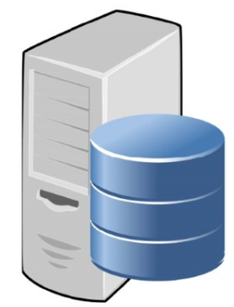
Introduction
Amazon Web Services provides fully managed relational and NoSQL database services, as well as fully managed in-memory caching as a service and a fully managed petabyte-scale data-warehouse service

Slide 5
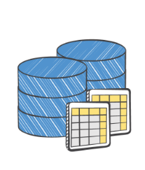
AWS Database Services
Amazon RDS
Amazon Aurora
MySQL
PostgreSQL
MariaDB
Oracal
MS SQL Server
Amazon DynamoDB
Amazon Redshift
Amazon Elasticache
AWS Database Migration Service

Slide 6


Amazon RDS
Amazon Relational Database Service (Amazon RDS) makes it easy to set up, operate, and scale a relational database in the cloud. It provides cost-efficient and resizable capacity while automating time-consuming administration tasks such as hardware provisioning, database setup, patching and backups. It frees you to focus on your applications so you can give them the fast performance, high availability, security and compatibility they need.

Slide 7

Amazon Aurora
Amazon Aurora is a MySQL and PostgreSQL compatible relational database built for the cloud, that combines the performance and availability of high-end commercial databases with the simplicity and cost-effectiveness of open source databases. Aurora is up to five times faster than standard MySQL databases and three times faster than standard PostgreSQL databases

Slide 8
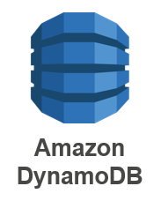
Amazon DynamoDB
Amazon DynamoDB is a fast and flexible NoSQL database service for all applications that need consistent, single-digit millisecond latency at any scale. It is a fully managed cloud database and supports both document and key-value store models.

Slide 9

Amazon Redshift
Amazon Redshift is a fast, fully managed data warehouse that makes it simple and cost-effective to analyze all your data using standard SQL and your existing Business Intelligence (BI) tools. With Amazon Redshift, you can start small for just $0.25 per hour with no commitments and scale out to petabytes of data for $1,000 per terabyte per year, less than a tenth the cost of traditional solutions.

Slide 10

Amazon Elasticache
Amazon ElastiCache is a web service that makes it easy to deploy, operate, and scale an in-memory data store or cache in the cloud. The service improves the performance of web applications by allowing you to retrieve information from fast, managed, secure in-memory data stores, instead of relying entirely on slower disk-based databases.
Amazon ElastiCache supports two open-source in-memory engines:
Redis
Memcached

Slide 11

Amazon Database Migration Service
AWS Database Migration Service helps you migrate databases to AWS quickly and securely. The source database remains fully operational during the migration, minimizing downtime to applications that rely on the database. The AWS Database Migration Service can migrate your data to and from most widely used commercial and open-source databases.

Slide 12


Slide 13


